Slide 1
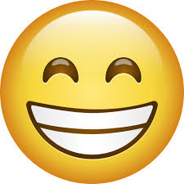
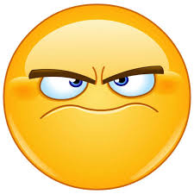
The words power point
Happy words and grumpy words

Slide 2
Happy words

Slide 3
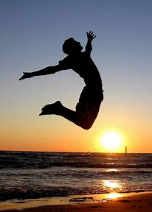
blithe
meaning
Ex
imgaes
"Blithe" means showing a casual and cheerful indifference that is considered to be callous or improper. It's often used to describe a happy, carefree attitude. For example, someone might be described as blithely ignoring the rules, meaning they’re unconcerned and light-hearted about things others might take more seriously.
If you didn’t under stand here is a sentence
:Despite the looming deadline, Jane had a blithe attitude as she strolled through the park, humming a tune and enjoying the sunshine. Her carefree nature was infectious, and soon her friends joined her, momentarily forgetting their worries.

Slide 4

Cheerful
meaning
ex
image
"Cheerful" refers to a state of being noticeably happy and optimistic. It describes someone who is in good spirits, often expressing joy or positivity in their demeanor and behavior. A cheerful person typically has a bright disposition and may uplift those around them with their positive attitude
If you didn’t under stand here is a sentence : Anna always has a cheerful smile on her face.
: Ahmad’s family is a cheerful funny family

Slide 5
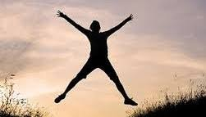
Exuberant
meaning
EX
image
"Exuberant" describes a lively and energetic state, often characterized by enthusiasm, joy, and vitality. It can refer to a person who is full of excitement and spiritedness, or it can describe things that are abundant and overflowing, such as exuberant growth in nature. Overall, it conveys a sense of enthusiastic and unrestrained energy.
If you didn’t under stand here is a sentence : Am sorry that my confidence was a little too exuberant.

Slide 6
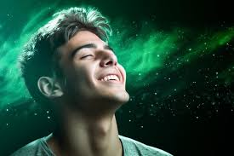
“Gleeful”
Meaning
ex
image
"Gleeful" describes a state of joy or delight, often marked by a lively and triumphant happiness. It typically conveys a sense of playful excitement or merriment, suggesting a feeling of pure joy and enjoyment in a particular moment or situation. A gleeful person might express their happiness through laughter, smiling, or other cheerful behaviors.
If you didn’t under stand here is a sentence: I was attacked for being gleeful, and for being sweet and reasonable.

Slide 7

Elated
MEANING
EX
IMAGE
"Elated" refers to a state of intense happiness or joy, often accompanied by feelings of excitement or exhilaration. When someone is elated, they typically feel uplifted and in high spirits, often as a result of a positive event or achievement.
If you didn’t under stand here is a sentence :By the end of the show, Grant was flushed from the heat, but elated.

Slide 8
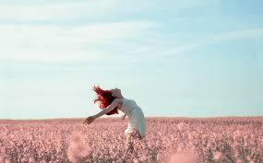
carefree
meaning
ex
Image
"Carefree" describes a state of being free from worries or concerns. It often implies a sense of lightness and enjoyment in life, where one is not burdened by responsibilities or stress. Someone who is carefree tends to approach life with a relaxed attitude, focusing on enjoyment and spontaneity.
If you didn’t under stand here is a sentence: Ashley laughed as she rolled around on the ground with Tommy, feeling carefree and happy.
the carefree days of the holidays.

Slide 9
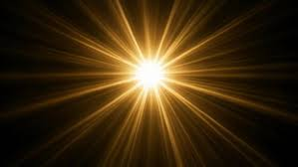
radiant
meaning
ex
images
"Radiant" refers to something that emits light or brightness, often in a glowing or shining manner. It can also describe a person or their expression as being filled with joy, warmth, or vitality, making them appear particularly vibrant or attractive. In essence, "radiant" conveys a sense of brilliance and positivity.
"She walked into the room with a radiant smile, instantly brightening the mood and lifting everyone's spirits."

Slide 10
Grumpy words

Slide 11
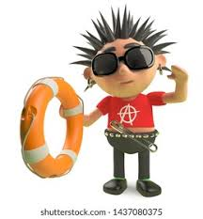
Prickly
meaning
ex
image
"Prickly" can refer to something that has sharp points or thorns, like a cactus or certain plants. In a figurative sense, it describes a person or situation that is irritable, easily offended, or difficult to deal with. For example, someone might have a prickly personality if they react sharply to criticism or have a tendency to be defensive.
"After a long night of tossing and turning, Jenna woke up feeling grouchy and snapped at everyone who tried to talk to her that morning’’

Slide 12
grouchy
meaning
ex
"Grouchy" refers to someone who is irritable, grumpy, or easily annoyed. It describes a person who often expresses dissatisfaction or has a bad temper. If you meant something else, please let me know
If you didn’t under stand here is a sentence :"After a sleepless night, he woke up feeling grouchy and snapped at anyone who spoke to him."2. "The grouchy old man always complained about the neighborhood kids making too much noise."3. "She was in a grouchy mood all day because of the rainy weather. "If "groughy" refers to something else, please clarify!

Slide 13

Churlish
meaning
ex
image
"Churlish" refers to someone who is rude, surly, or ill-mannered. It describes behavior that is boorish or uncivilized, often involving a lack of courtesy or kindness. A churlish person may be ungracious, dismissive, or difficult to interact with, showing little regard for social norms or the feelings of others.
If you didn’t under stand here is a sentence :The room was so lovely it seemed churlish to argue.

Slide 14
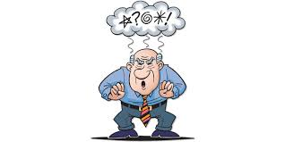
Crotchety
meaning
ex
image
"Crotchety" describes someone who is irritable, grumpy, or prone to sudden changes in mood. It often implies a quirky or eccentric nature, along with a tendency to complain or be difficult to please. A crotchety person might be cantankerous and frequently express dissatisfaction or annoyance.
"If my feet are comfortable, then I don't get crotchety and start moaning."

Slide 15
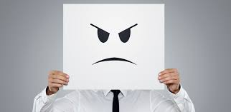
Cantankerous
meaning
ex
image
"Cantankerous" describes someone who is bad-tempered, argumentative, and difficult to deal with. It often refers to a person who is prone to being irritable and quarrelsome, making interactions with them challenging. The term conveys a sense of stubbornness and a tendency to be uncooperative or grumpy.
If you didn’t under stand here is a sentence :"he won't agree to anything, he's so cantankerous"
"my grandfather's a cantankerous old man

Slide 16
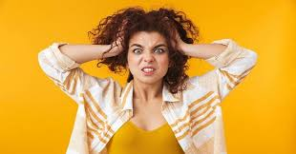
Waspish
meaning
ex
image
"Waspish" describes someone who is sharp-tongued, irritable, or prone to making cutting or sarcastic remarks. It conveys a sense of being easily annoyed and having a tendency to be critical or biting in conversation. The term often implies a quickness to express displeasure or to sting with words, much like a wasp might sting.
If you didn’t under stand here is a sentence :his waspish humor came out in his theatre reviews"

Slide 17
Made by
Youssef Ragab
Hamza Ahmed
Thomas Emad
Document
https://hamzaahmedcollab.github.io/myweb/index

